Slide 1



1. Introduction to the Stock Market
Ansh Chaurasia
The Stock Market is a place where people buy and sell pieces of companies, called "stocks" or "shares." When you buy a stock, you own a small part of that company. The stock market helps companies get money and allows people to invest in those companies.
Made bB: Ansh Chaurasia

Slide 2
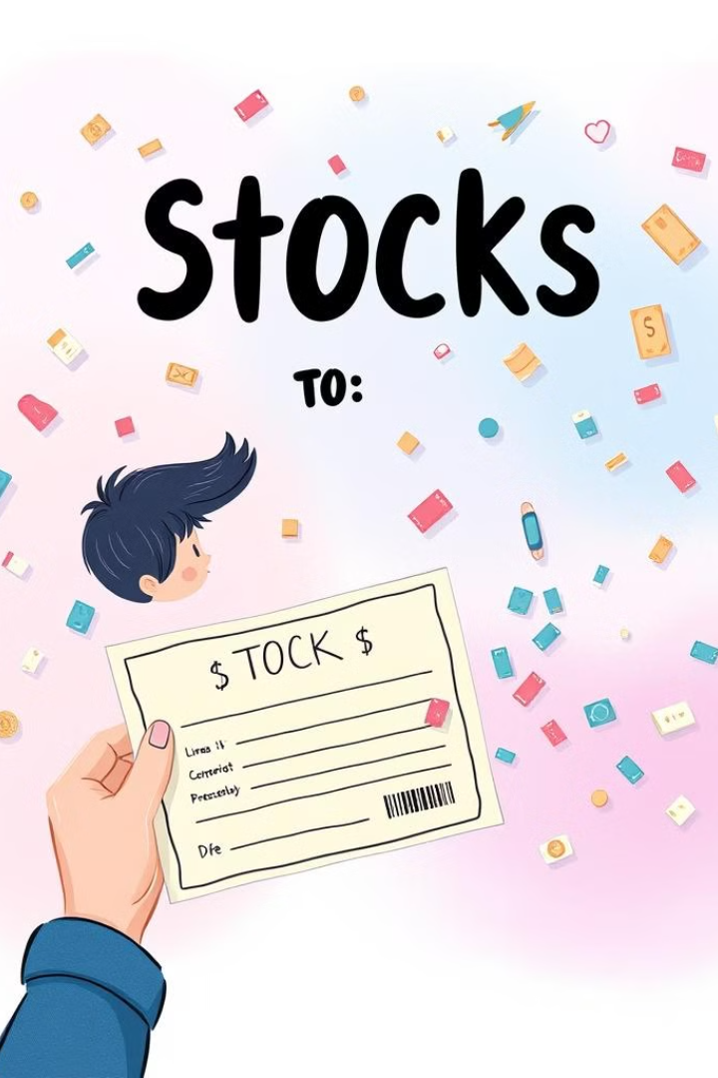
2. What Are Stocks?
Ansh Chaurasia
Stocks are like tiny pieces of a company. When you own a stock, you own part of that company. If the company does well, your stock value goes up. Sometimes, companies pay money (called dividends) to stockholders from their profits.

Slide 3
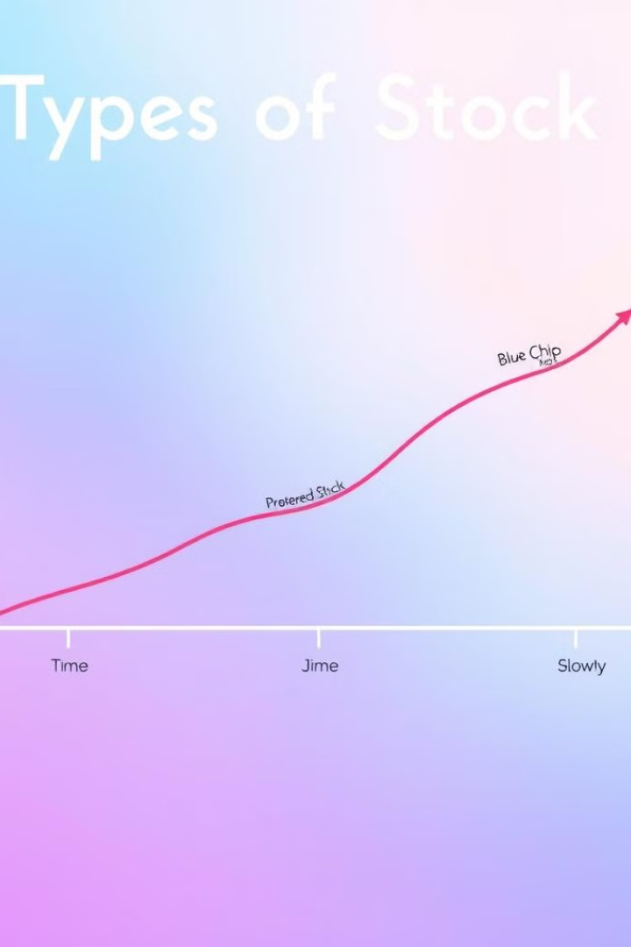
3. Types of Stocks Growth Stocks:
Growth Stocks: Stocks from companies that are expected to grow quickly. These don’t usually pay dividends but increase in value.
Ansh Chaurasia
Dividend Stocks: Stocks from companies that share their profits with you through regular payments.
Value Stocks: Stocks that are priced lower than what they’re actually worth and have a good chance of growing in the future.

Slide 4

4. How the Stock Market Works
Ansh Chaurasia
Stocks are bought and sold on places called stock exchanges (like the NYSE or Nasdaq). When more people want to buy a stock than sell it, the price goes up. If more people want to sell than buy, the price goes down.

Slide 5

5. Key Stock Market Exchanges
Ansh Chaurasia
NYSE (New York Stock Exchange): A major exchange in the U.S.
Nasdaq: Another big exchange known for tech companies. LSE (London Stock Exchange): The main exchange in the UK.
TSE (Tokyo Stock Exchange): Japan’s main stock exchange.

Slide 6

6. Factors Affecting Stock Prices
Stock prices can change because of: Company News: Good or bad news about a company can change its stock price.
Ansh Chaurasia
Economy: Things like interest rates and inflation can affect the stock market. Market Mood: How investors feel about the economy or a company can influence stock prices.
Market Mood: How investors feel about the economy or a company can influence stock prices.
Global Events: Things happening around the world (like wars or natural disasters) can also affect stock prices.

Slide 7

7. Stock Market Indices:
Indices are groups of stocks that show how the stock market is doing. Some well-known ones are:
Ansh Chaurasia
S&P 500: Shows how the top 500 U.S. companies are performing.
Dow Jones: Tracks 30 big companies in the U.S.
Nasdaq Composite: Includes many tech companies.

Slide 8

8. Types of Investors
Retail Investors: Regular people like you and me who buy and sell stocks.
Institutional Investors: Big companies like pension funds or mutual funds that invest large amounts of money.
Ansh Chaurasia
Day Traders: People who buy and sell stocks quickly in a single day to make fast profits.
Long-Term Investors: People who buy stocks and keep them for many years, hoping the company grows over time.

Slide 9

9. Basic Stock Market Strategies
Buy and Hold: Buying stocks and keeping them for a long time.
Ansh Chaurasia
Dollar-Cost Averaging: Investing the same amount of money regularly, no matter what the stock price is.
Swing Trading: Buying stocks and selling them after a short time to make a profit from price changes.
Value Investing: Buying stocks that are cheap right now but could increase in value later.

Slide 10

10. The Risks and Rewards of Investing in Stocks Rewards:
Ansh Chaurasia
If the company does well, the stock price goes up and you can make money. You can also get dividends.
Risks: Stock prices can go down, and you could lose money if the company doesn’t do well or if there’s a market crash.

Slide 11
Summary
The stock market is a platform where individuals buy and sell shares, which are small ownership units of companies. When you purchase a stock, you become a partial owner of that company, with the potential to earn profits through price appreciation or dividends. Stocks come in different types—growth stocks (focused on rapid expansion), dividend stocks (offering regular income), and value stocks (undervalued with future growth potential). Stock trading occurs on major exchanges like the NYSE, Nasdaq, LSE, and TSE, where prices fluctuate based on supply and demand. Several factors influence these price movements, including company news, economic conditions, investor sentiment, and global events. To track market performance, indices like the S&P 500, Dow Jones, and Nasdaq Composite are commonly used. Investors themselves can be categorized into groups such as retail investors, institutional investors, day traders, and long-term investors, each with different goals and strategies. Common investment strategies include buying and holding stocks, investing consistently through dollar-cost averaging, short-term swing trading, and value investing. While the stock market offers the potential for significant returns, it also carries risks, such as market downturns and company failures, making it essential for investors to understand both the opportunities and challenges involved.
Ansh Chaurasia
Thanks For Your Corporation!
Presentation is Made By:
Ansh Chaurasia

